Slide 1
Selenium Project
Amazon Laptop Search Automation

Slide 2
Introduction
This presentation covers the automation of laptop searches on Amazon using Selenium combined with Cucumber and Gherkin for behavior-driven development. It demonstrates how to filter limited-time laptop deals and rank the top 10 laptops by discount percentage. The project also includes comprehensive logging and reporting using Allure for enhanced test result visualization.

Slide 3
01
Selenium Project Overview

Slide 4

Introduction to Selenium and Cucumber
Selenium is a powerful open-source tool for web automation, widely used for testing web applications. Cucumber complements Selenium by enabling Behavior-Driven Development (BDD) through readable test scenarios in natural language. Together, they allow for robust and maintainable test automation scripts that simulate user interactions on Amazons website.

Slide 5
Using Gherkin for Behavior-Driven Development
Gherkin syntax is used to write structured, human-readable test cases, facilitating communication between technical and non-technical stakeholders. It defines features with scenarios composed of Given, When, Then steps, ensuring clarity and precision in describing test behavior for the Amazon laptop search and discount ranking automation.

Slide 6
Setting Up the Amazon Laptop Search Scenario
To initiate the Amazon laptop search automation, the project configures Selenium WebDriver to navigate and interact with the Amazon website. The test scenario involves searching for laptops, applying filters for limited-time deals, and validating the presence of discounted products. This setup provides a foundation for further filtering and data extraction in subsequent steps.

Slide 7

01
Test Implementation and Reporting

Slide 8
Automating Laptop Search and Deal Filtering
The automation script performs a keyword search for laptops on Amazon and programmatically applies filters to isolate laptops under the limited-time deal category. This ensures that only relevant, discounted items are retrieved, improving test accuracy and efficiency by focusing on time-sensitive offers and potential deals valuable to users.

Slide 9
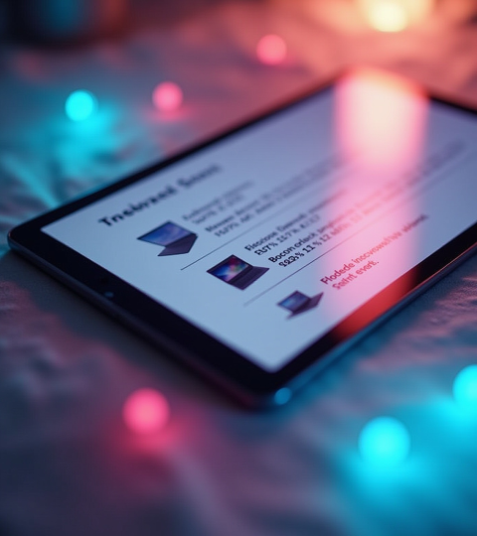
Displaying Top 10 Laptops by Discount Percentage
After filtering, the script collects data on laptops’ prices and discounts, sorts the list in descending order based on discount percentage, and extracts the top 10 entries. This ranking helps highlight the best deals, providing clear insights into which products offer the greatest savings at that moment.

Slide 10
Integration of Logs and Allure Report for Test Results
Comprehensive logging is embedded throughout the test process to track execution flow and capture any issues. Results are compiled into an Allure report, delivering a detailed, user-friendly visualization of test outcomes, including passed, failed cases, and screenshots, enhancing debugging and auditability for stakeholders.

Slide 11
Conclusions
This project successfully demonstrates how Selenium and Cucumber can be integrated to automate complex e-commerce workflows, such as searching, filtering, and ranking laptop deals on Amazon. The use of Gherkin makes test scenarios clear and maintainable, while integrated logging and Allure reporting provide robust insights into testing results, ensuring reliability and transparency.

Slide 12
Thanks!
Ashmeet Kaur
Submitted to :Ms.priyanka

